Slide 1
Evaluating the Reach and Effectiveness of the YMCA Diabetes Control Program:
Preliminary Findings
Briana Mezuk, PhD & Joshua Montgomery, BS
VCU Department of Family Medicine & Population Health
October 4, 2016

Slide 2
RE-AIM Framework for guiding our research on the Diabetes Control Program
Reach: Who does this program serve?
Effectiveness: Does the program work?
Adoption: What are the facilitators and barriers to training program staff?
Implementation: How to deliver the program in a consistent manner?
Maintenance: How to keep the program sustainable?
http://www.re-aim.hnfe.vt.edu/
Notes:
The RE-AIM framework is designed to enhance the quality, speed, and public health impact of efforts to translate research into practice in five steps.
Today we will talk about our findings regarding the REACH and EFFECTIVENESS of the YMCA Diabetes Control Program

Slide 3
Methods
Where does this data come from?
Self-report surveys completed by participants at the beginning (week 1 or 2) and end (week 11 or 12) of the DCP
  VCU students, cross-trained as YMCA volunteers, manage this data under supervision of YMCA staff
  Data is made anonymous (stripped of names and any other identifiers) and transferred to VCU for analysis by Dr. Mezuk
  Project is approved by the VCU Institutional Review Board (#HM20003645)
In the process of also conducting focus groups with DCP participants (more on this next time)
  Also approved by the VCU IRB (#HM20007800)

Slide 4
REACH
What are the characteristics of people who participate in the YMCA DCP?

Slide 5
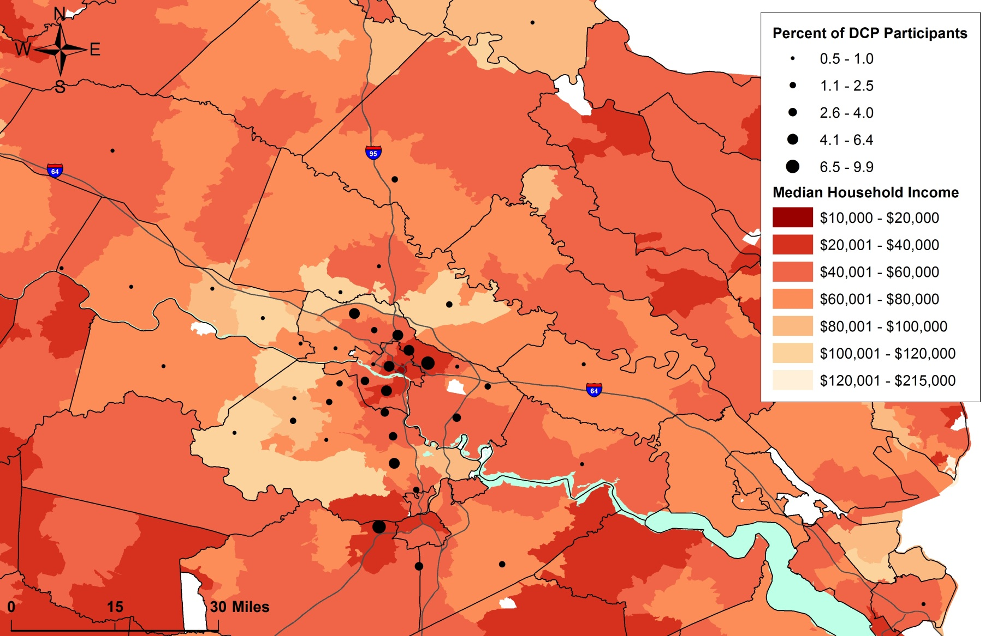
Geographic REACH
Map of DCP participants by zip code and median household income
Notes:
This map shows the GEOGRAPHIC REACH of the DCP. It shows that the program draws mostly from the Richmond metro area, but also reaches north (toward Louisa county) and east (toward New Kent). It also shows that many participants, particularly in the Richmond area, are coming from lower-income parts of the city. This means that the program is reaching those who are often missed or left-out of other programs. Part of this is because the DCP has a relationship with the Virginia Coordinated Care Program (VCC, a healthcare program for lower-income patients who do not qualify for Medicaid) and patients with diabetes are often referred from that program.

Slide 6
Demographic Characteristics of the Diabetes Control Program Participants
Average age: 54 years (range: 21 – 88 years)
73% female
70% African American, 25% white
43% are currently employed at least part-time, 23% are on disability & 20% are unemployed
41% have a high school education or less, and 46% have at least some college education

Slide 7
Participant Engagement

Slide 8
Overall attendance over the DSMP
% Attending
Week of class
Notes:
Classes attended (mean, range) (n=228) = 8.6 (1 – 12)
Classes attended
≤3 = 20 (8.8%)
4 to 6 = 27 (11.8%)
7 to 9 =73 (32.0%)
≥10 = 108 (47.3%)
Attend 8 or more classes (retention) = 164 (71.9%)

Slide 9
Average attendance in the DSMP
Overall (bar) and by coaches (dots)
N=228 participants
Number of classes attended

Slide 10
CLINICAL IMPACT

Slide 11
Average change in HbA1c over the DSMP:
Overall average (bars) and average for each coach (lines)
N=81 participants
Average HbA1c (%)

Slide 12
Average change in weight over the DSMP:
Overall average (bars) and average for each coach (lines)
N=85 participants
Average weight (lbs)

Slide 13
Relationship between readiness for change and change in HbA1c

Slide 14
Quote from focus group

Slide 15
Take home points
Reach of the program
Large service area that goes beyond metro RIC
  Good reach into lower-income neighborhoods
Participants are in their early-50s and primarily African American, female, and not currently employed
Most have had diabetes for >5 years

Slide 16
Take home points
Engagement with the program
Attendance is good, but declines over time
  70% attend 8 or more classes
Positive reviews of group-format of class
Lower attendance for people with <high school education and who were unemployed
Coaches differ in their retention rates

Slide 17
Take home points
Clinical impact of the program
Clinically- and statistically-significant decline in HbA1c over the 12-week class
  Average decline: 0.93 points (range: -2 to +7.6)
Increase in frequency of blood glucose monitoring
No change in weight
Some variability in impact across coaches
Readiness modestly correlated with drop in HbA1c

