Slide 1
Progress on our Community Engagement grant
“Strengthening a community-engaged research partnership to promote diabetes management in Richmond”
Briana Mezuk, PhD
Department of Family Medicine & Population Health

Slide 2
Logistics
Funded the VCU Council for Community Engagement
Funding period: 7/1/2016 – 6/30/2017
Total amount: $18,000

Slide 3
Overarching project goal
To strengthen our existing partnership between the YMCA of Greater Richmond and VCU through community-engaged research focused on addressing disparities in diabetes care and outcomes.

Slide 4
Objective 1
To identify and disseminate best-practices for community-oriented diabetes self-management programs by evaluating the YMCA-developed Diabetes Control Program within the RE-AIM framework using quantitative and qualitative methodologies.

Slide 5
Objective 2
To catalyze community-engaged learning for VCU students through their involvement in all processes of this mixed-methods evaluation through internship, practicum, and service-learning programs.

Slide 6
Objective 3
To build substantial community-engaged research capacity regarding diabetes in Richmond through the:
Creation of a Community Advisory Board as co-learning process and a means of engaging community members and stakeholders,
Mutual exchange of partner expertise, training, and resources; and
Scholarship dissemination via public events, newsletters, and jointly-authored publications.

Slide 7
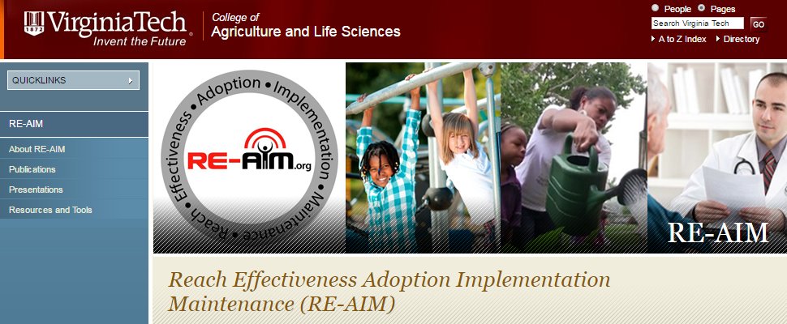
RE-AIM Framework
Designed to enhance the quality, speed, and public health impact of efforts to translate research into practice
Reach
Effectiveness
Adoption
Implementation
Maintenance

Slide 8
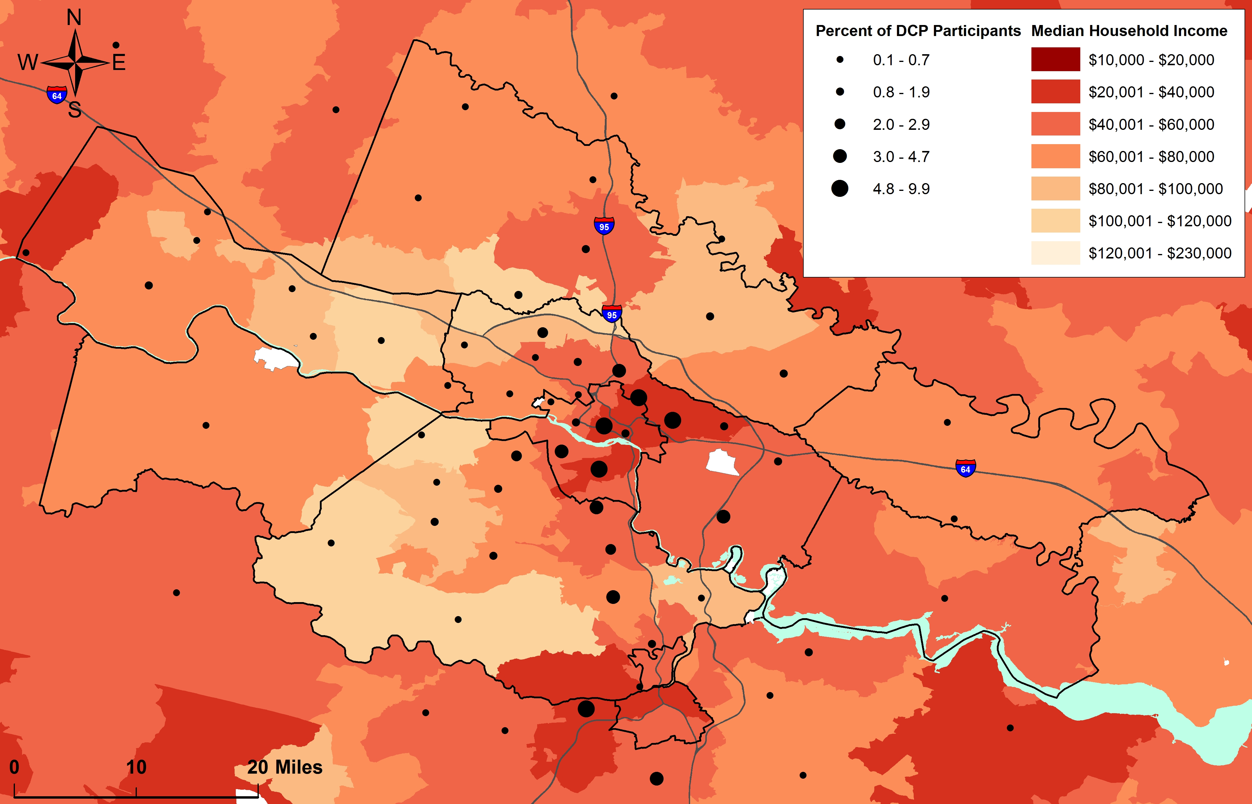
Geographic REACH of the YMCA program
Notes:
Updated april 2017
This map shows the GEOGRAPHIC REACH of the DCP. It shows that the program draws mostly from the Richmond metro area, but also reaches north (toward Louisa county) and east (toward New Kent). It also shows that many participants, particularly in the Richmond area, are coming from lower-income parts of the city. This means that the program is reaching those who are often missed or left-out of other programs. Part of this is because the DCP has a relationship with the Virginia Coordinated Care Program (VCC, a healthcare program for lower-income patients who do not qualify for Medicaid) and patients with diabetes are often referred from that program.

Slide 9
Clinical impact on glycemic control
HbA1c before and after the program (N=141)
Average change: 0.76 (range: -6.5 to +7.6)
Average HbA1c (%)
Notes:
UPDATED 4.4.17
Remember: Positive (>0) values of change in HbA1c are GOOD because this is calculated from PRE-HbA1c [minus] POST-HbA1c.
Average person experienced almost a 1-point DROP (0.76 (range: -6.5 to + 7.6) HbA1c. Very few people experienced an increase in HbA1c. This difference is both CLINICALLY SIGNICIANT and STATISTICALLY SIGNIFICANT

Slide 10
Impact on weight
Weight before and after the program (N=141)
Average weight (lbs)
Notes:
Updated april 4 2017
Weight at baseline (N=141) (mean, range): 229.5 (129.6 – 425)
Weight at follow-up (N=141) (mean, range): 227.91 (123 – 425)
Average change in weight in lbs (N=85) (mean, range): -1.29 (-34.2 – 87.2)

Slide 11
Impact on mental health
Depressive symptoms before and after the program (N=111)
Average PHQ8 score
Notes:
Updated april 4 2017

Slide 12
Impact on self-management behaviors
Glucose monitoring before and after the program (N= 144)
Days in past week checked sugar
Notes:
Created april 2017

Slide 13
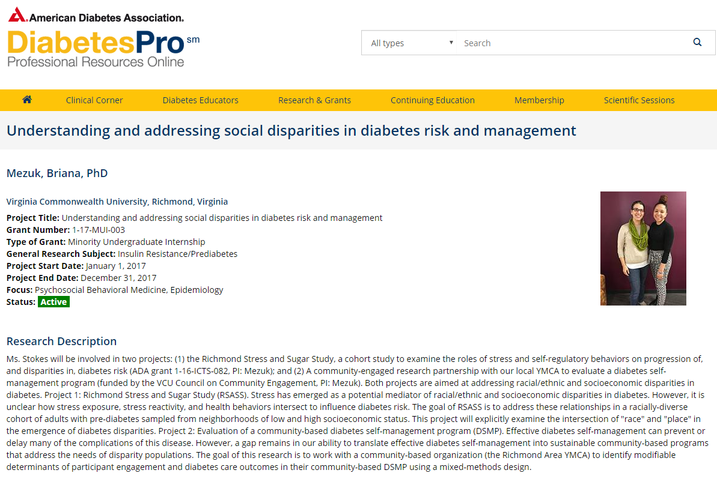
Progress on Aim 2
Minority Undergraduate Internship funded for McKenzie Stokes by the American Diabetes Association (1-17-MUI-003)

Slide 14
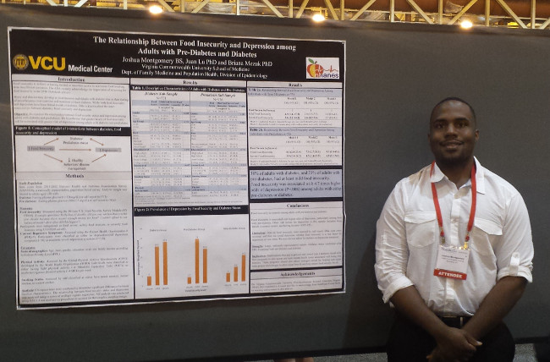
Progress on Aim 2
MPH student Josh Montgomery presents at the American Diabetes Association

Slide 15
Progress on Aim 3
Community Advisory Board has met 4 times (including today)
Board is comprised of a diverse set of stakeholders, representing people with diabetes, state government, healthcare providers, insurers, and alumni from the program

Slide 16
How is the CAB helping us accomplish our shared goals?
Scientific Approach
  Revisions of YMCA DCP surveys
Dissemination efforts
  Infographics for key stakeholder groups
  Raising awareness about the program in Richmond
  Taking dissemination efforts to a national stage

Slide 17
Dissemination in public forums
Dec. 2016: VCU Epidemiology Seminar Series
Jan. 2017: UM School of Public Health Seminar Series
Apr. 2017: Virginia Weight of the State conference
Virginia Public Health Association conference
May 2017: VCU Council on Community Engagement
Diabetes Forecast article
June 2017: American Diabetes Association
July 2017: Planned submission of scientific manuscript
Aug 2017: American Association of Diabetes Educators
Nov 2017: American Public Health Association

Slide 18
Next steps
Conduct interviews with DCP coaches to complete our RE-AIM evaluation
Work with VCU Department of Psychology to develop new methods of training coaches to promote engagement in the program
Analyze data on individuals who express interest, but do not enroll, to identify ways to support recruitment
Apply for NIH funding (July 2017) to test ways to enhance the program and develop a toolkit for training other Y

Slide 19
Long-term vision
The outcomes of this project will directly benefit participants of DCP through improvements made to the program based on our findings
Through the YMCA-VCU partnership, innovative and practical approaches will be identified to improve diabetes programs and outcomes in the region
Through collaboration with the CAB these strategies will be shared with community stakeholders to build a sustainable network of support for managing diabetes in Richmond.

Slide 20
Summary of project timeline
Aim 1: DCP pre/post surveys
Aim 1: Focus groups & coach interviews
Aim 2: Student engagement
Aim 3: Strengthening partnership & dissemination
Analysis complete
Preparing factsheets and scientific publications
Collection: July/Apr
Analysis: Apr/Jun
Ongoing
Quarterly CAB meetings
Dissemination plans

